Slide 1

Working with Embeddings Part 4

Slide 2
Nicholas A. Christakis
“Whether we appreciate it or not, we live out our lives surrounded by an intricate pattern of social connections... We're all embedded in this network; it affects us profoundly and we may be unaware of its existence, of its effect on us.”
Notes:
https://www.sjsu.edu/writingcenter/docs/handouts/Embedding%20Quotations.pdf

Slide 3



Notes:
https://www.youtube.com/channel/UC35ZpwldGw7ZJ5R-2sLijzw

Slide 4


Membership has its privileges
Notes:
https://www.youtube.com/channel/UC35ZpwldGw7ZJ5R-2sLijzw/join

Slide 5
Real World Examples
How to Actually Use Embeddings

Slide 6
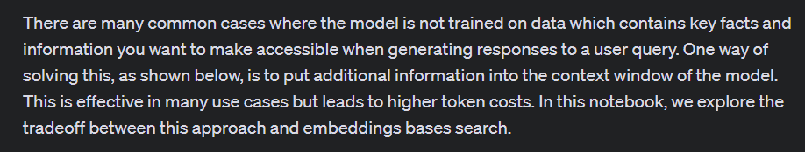
Answering Questions
Notes:
https://github.com/openai/openai-cookbook/blob/main/examples/Question_answering_using_embeddings.ipynb

Slide 7
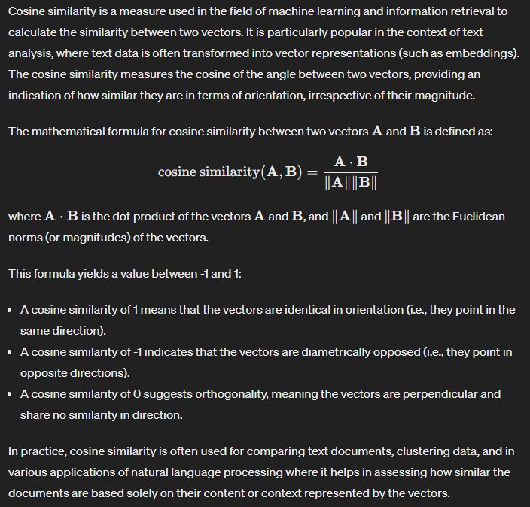
What is Cosine Similarity?

Slide 8
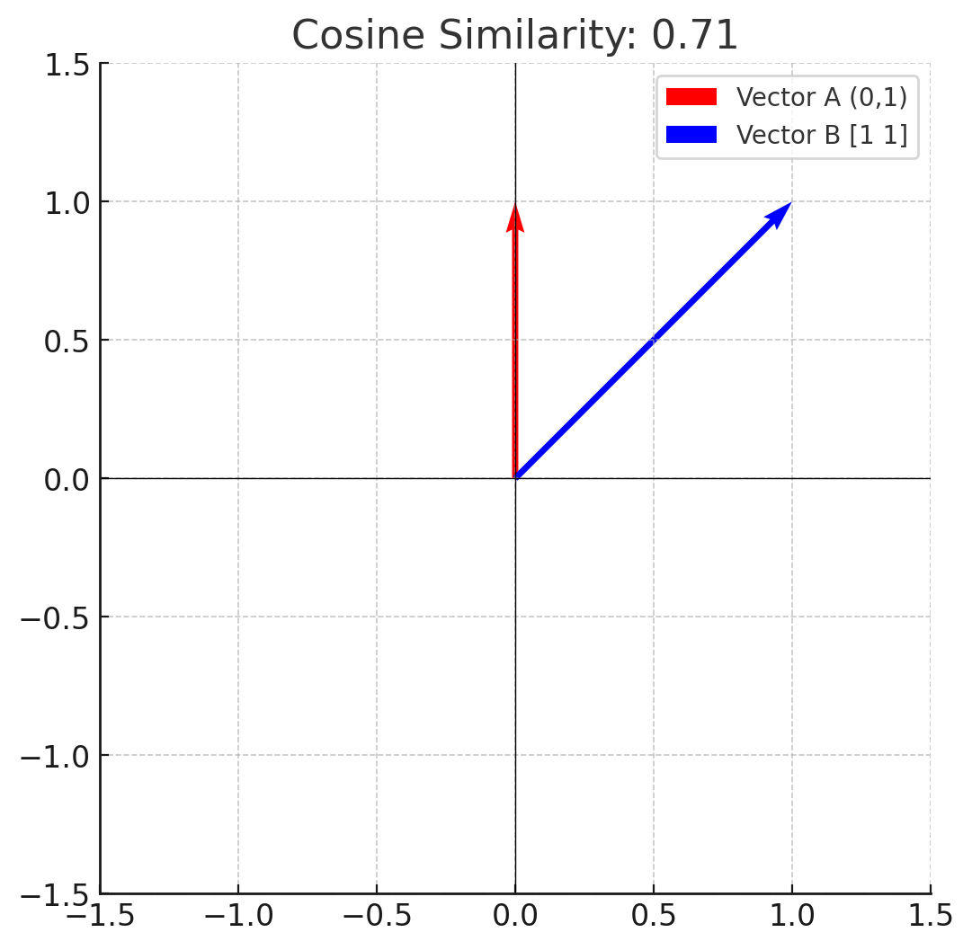
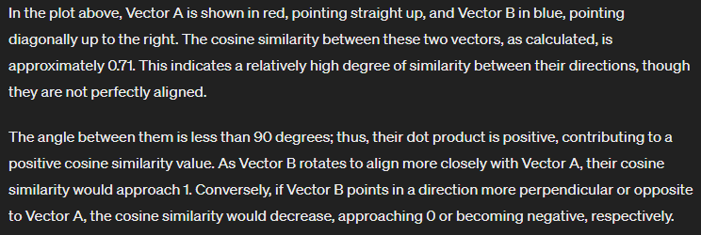
Do What now?

Slide 9
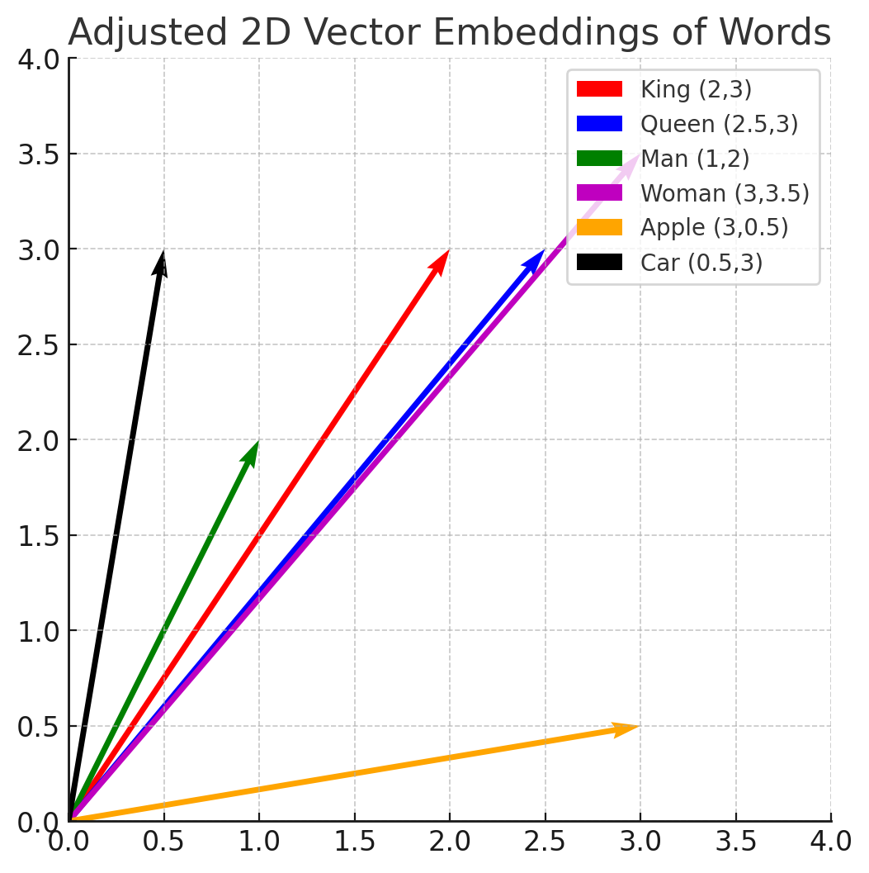
A Semantic Example

Slide 10
Demo: Getting Related Items
def strings_ranked_by_relatedness(
query: str,
df: pd.DataFrame,
relatedness_fn=lambda x, y: 1 - distance.cosine(x, y),
top_n: int = 100,
threshold: float = 0.001
) -> tuple[list[str], list[float]]:

Slide 11
Demo: Asking a Question
def ask(
query: str,
df: pd.DataFrame = df,
model: str = 'gpt-4-turbo',
token_budget: int = 4096 - 500,
print_message: bool = False,
) -> str:
"""Answers a query using GPT and a dataframe of relevant texts and embeddings."""
message = query_message(query, df, model=model, token_budget=token_budget)
if print_message:
print(message)
messages = [
{"role": "system", "content": "You answer questions about Amazon Food Reviews."},
{"role": "user", "content": message},
]
response = client.chat.completions.create(
model=model,
messages=messages,
temperature=0
)
response_message = response.choices[0].message.content
return response_message

Slide 12
Semantic Search

Slide 13
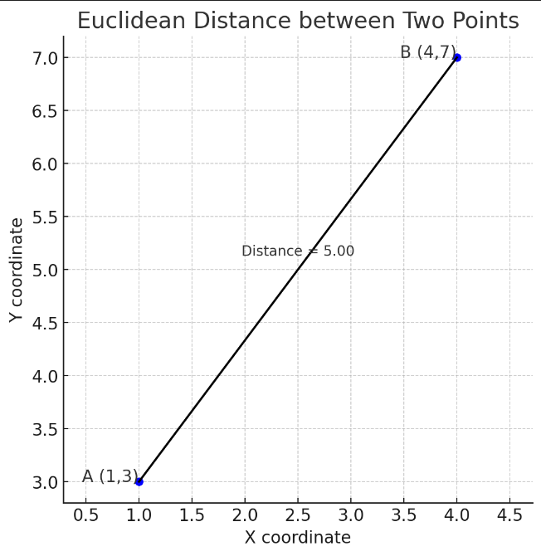
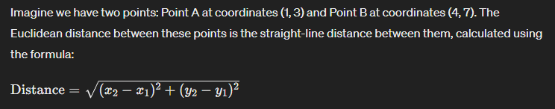
Euclidean Distance

Slide 14
Demo: Semantic Search
def strings_ranked_by_relatedness_ed(
query: str,
df: pd.DataFrame,
relatedness_fn=lambda x, y: -distance.euclidean(x, y),
top_n: int = 100
) -> tuple[list[str], list[float]]:
"""Returns a list of strings and relatednesses, sorted from most related to least."""
query_embedding_response = client.embeddings.create(
model='text-embedding-3-large',
input=query,
)
query_embedding = query_embedding_response.data[0].embedding
strings_and_relatednesses = [
(row["combined"], relatedness_fn(query_embedding, row["embedding"]))
for i, row in df.iterrows()
]
strings_and_relatednesses.sort(key=lambda x: x[1], reverse=True)
strings, relatednesses = zip(*strings_and_relatednesses)
return strings[:top_n], relatednesses[:top_n]

Slide 15
Recommendation
Embeddings + Nearest Neighbor Search
Notes:
https://cookbook.openai.com/examples/recommendation_using_embeddings

Slide 16
Demo: Recommendations
def distances_from_embeddings(query_embedding, embeddings, distance_metric="cosine"):
"""
Calculate distances from the query embedding to each embedding in the list.
Parameters:
query_embedding (array): The embedding of the query string.
embeddings (list of arrays): A list of embeddings to compare against.
distance_metric (str): The metric used to calculate distance, default is "cosine".
Returns:
list: Distances from the query embedding to each embedding in the list.
"""
distances = []
for emb in embeddings:
dist = distance.cosine(query_embedding, emb) if emb is not None else np.inf
distances.append(dist)
return distances

Slide 17
Revisiting Visualizing the Data in 2D Space
Reducing the Dimension for Human Understanding

Slide 18
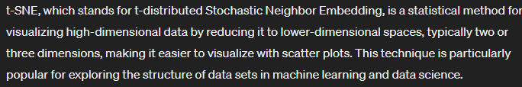
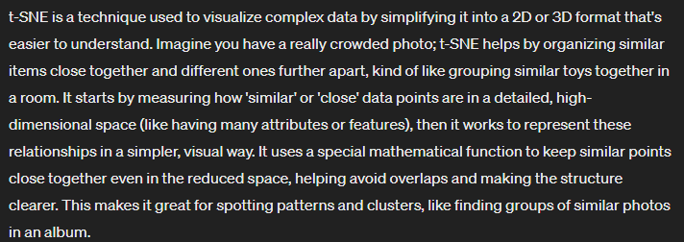
t-SNE: t-distributed Stochastic Neighbor Embedding

Slide 19
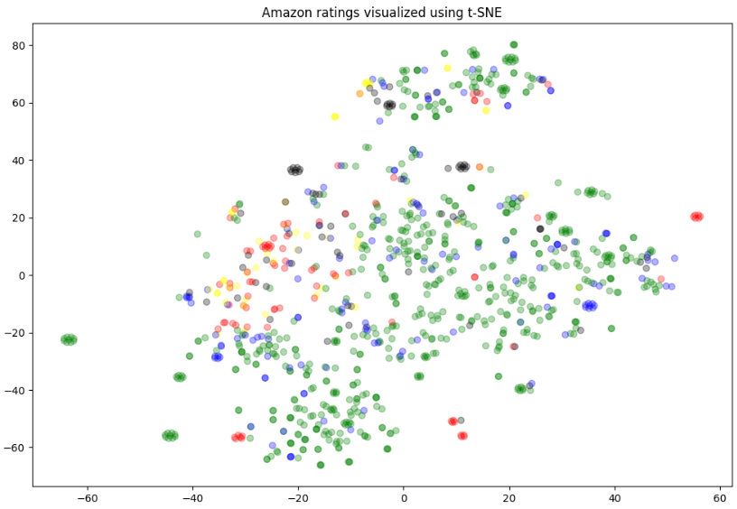
Demo: Visualizing the Data

Slide 20


